Slide 1



Cyber Security
Introduction
We'll learn about cybersecurity in industrial control. We'll look at the Purdue Model for Industrial Control Systems, understand the difference between Operational Technology (OT) and Information Technology (IT) networks, talk about dealing with cyber threats, and focus on basic cybersecurity principles like Defense in Depth and the Layered Approach to ICS Security Architecture.

Slide 2
Module 1: Course
Introduction
Module 2: Overview
of Control Systems
Module 3: Cyber
Security Introduction
Module 4:
IEC 62443
Foundational
Requirements
Module 5:
Cyber Security In-
Depth
Module 6:
Course Close Out

Slide 3
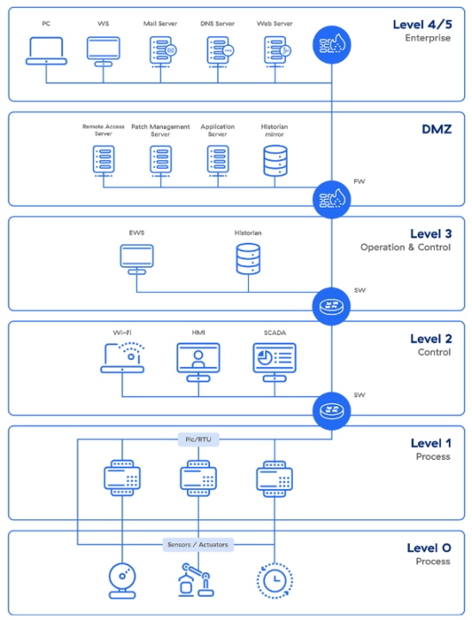
Purdue Model
The Purdue model is a structural model for industrial control system (ICS) security that concerns segmentation of physical processes, sensors, supervisory
controls, operations, and logistics.

Slide 4
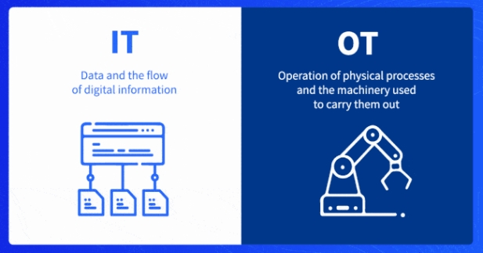
Difference Between
OT and IT Networks
Operational technology (OT) is the hardware and software that monitors and controls devices, processes, and infrastructure, and is used in industrial settings. IT combines technologies for networking, information processing, enterprise data centers, and cloud systems. OT devices control the physical world, while IT systems manage data and applications.

Slide 5
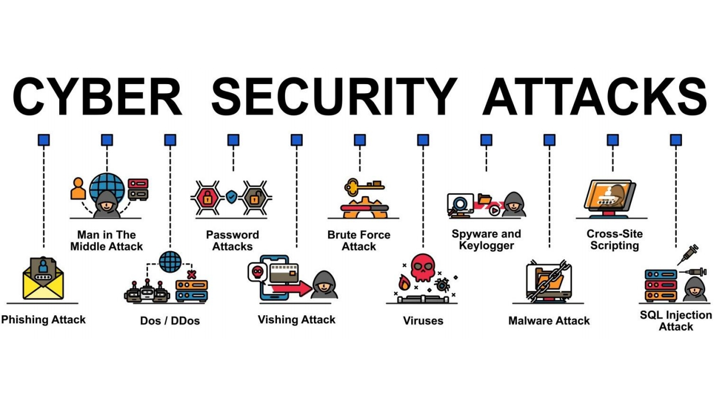

Slide 6
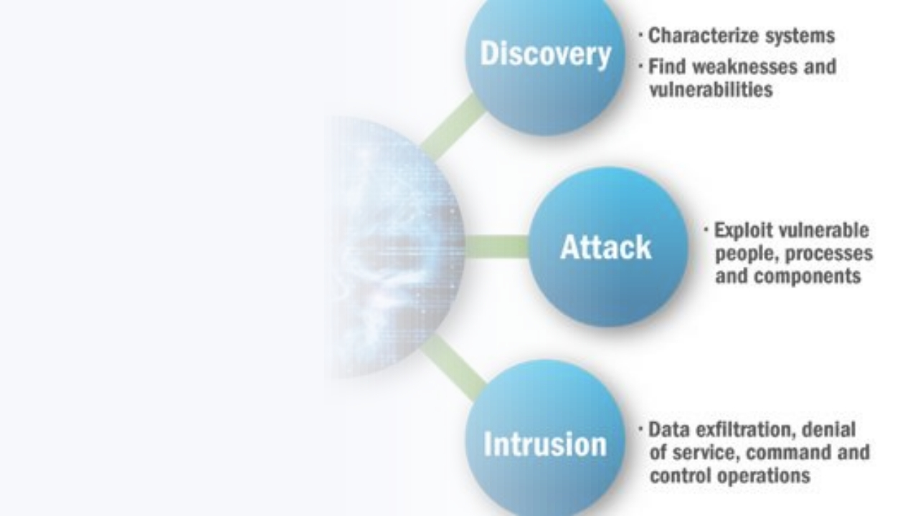
Anatomy of a
Cyber Attack
Understanding Cybersecurity:
Grasp cyber attack concept for comprehensive defence.
Know methods malicious actors use to exploit vulnerabilities.
Similarity to techniques security pros use for testing.
Insight into approaches helps
implement effective defense strategies.

Slide 7
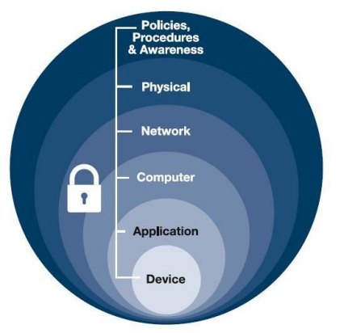

Defense in depth is a strategic approach
Defense in
that leverages
multiple layers of
Depth
security measures to
protect an
organization's assets.

Slide 8
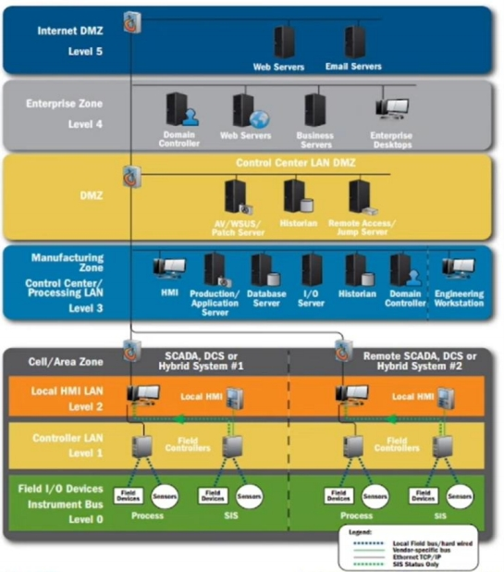


Control system Architectures
Heightened
Reliance on
Automation and
Control Systems
Utilization of
Insecure External
Technologies with
Network
Known
Connectivity
Vulnerabilities
Absence of a
Limited Security in
Inadequate
Business Case for
Control System
Security in
Cybersecurity
Technologies
Communication
Protocols
Availability of
Open Source
Information

